Slide 1



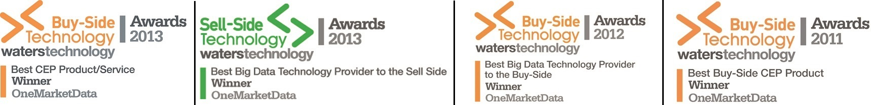
ONETICK™ product overview
Complex Event Processing seamlessly integrating the analysis of real-time streaming and historical market data
ONETICK cep
ONETICK
database
ONEQUANTDATA
data
Enabling Financial Firms to Outmaneuver their Competition
Tick data management for the capture, store, retrieval and analysis of historical tick data for any asset class.
Comprehensive repository of reference & pricing data for the global equities market. Daily prices, corporate actions, earnings, trading volumes and company information.

Slide 2
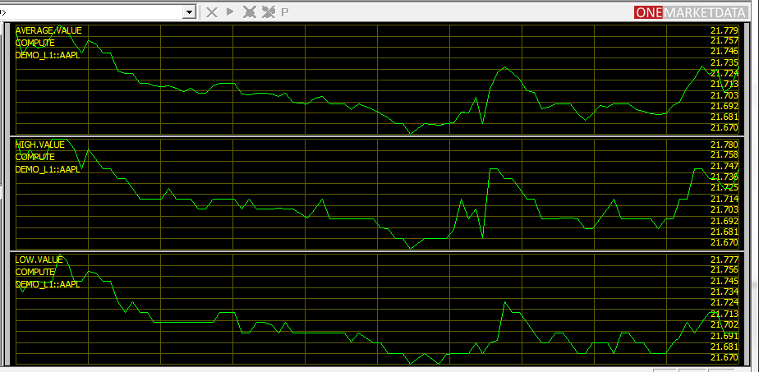





Who is OneMarketData?
President and Founder, Leonid Frants, Ph. D.
Technology Built by Wall Street experts…
Our Pedigree
Goldman Sachs
Singularity
Market Data
ONETICK
Trading Systems
Financial Analytics
Commercial and Enterprise Software
O f Vision
Founded in 2005, Profitable in 2008
Self-Funded & Self-Directed. No venture capital
Cash-flow positive
Notes:
Our President & Founder Dr. Leonid Frants has more than 15 years’ experience building financial data management systems, with our head of engineering they developed those skills and an in-depth understanding of capital markets at Goldman Sachs.
Dr. Frants formed our company in 2005 and with a Singularity of Vision has built a company by assembling a team of people from across the industry with expertise in market data, trading systems, mathematics and analytics and commercial/enterprise software. That vision is to deliver innovative market-leading technology for quantitative research and trading solutions. Since then we’ve managed a successful and profitable business with over 70 customers across the financial industry.

Slide 3









































Our Customers
The top names in finance turn to OneMarketData for all their data management needs.
Bloomberg
Goral Trading
Notes:
Notes:
Marketplaces – NYSE.com, TradeWeb, Euronext
Information and Technology Providers – CNBC, Bloomberg, TradingScreen, Instinet
Large Online Brokerage houses – Credit Suisse, JP Morgan, TD Securities, RBC,
… new (announced Retail client), currently under a very successful evaluation of OneTick with over 200,00 online users.
Key points:
ease of use of analytics (vs. relational),
constructing queries: dynamic queries vs. static fixed-function API’s in other products
Cost (vs. Oracle and it’s db admin + building analytics)

Slide 4






Our Customers
The top names in finance turn to ONETICK for all their data management needs.
Goral Trading
Over 80 Clients Worldwide
Hedge Funds Prop Shops Retail Brokers Banks/Brokers Asset Managers Market Places Technology Providers
Notes:
Notes:
The existing customers that use the ONETICK products are broad and diverse within the financial industry. From small/mid-side prop trading firms to global investment banks and asset managers. Includes technology and information providers leverage the ONETICK products within their own offering for a more compelling solution.
Over 80 customers in the 7 years on the company’s existence is clear indication of the value and quality of the ONETick products.

Slide 5




Who is a ONETICK user?
Trader
Portfolio Manager
Manage Investment decisions, costs and risks
Algo Deployment
Transaction Cost Analysis
Execute Models in Market
Design new ideas graphically
Trade LifeCycle
Back Testing and Optimization
Quantitative Analyst
Algo Developer
Research and Alpha Discovery
Research historical data for market price inefficiencies due to …
Geo-political events, human behavior, market structure
Algo Development
Turn Quant Research into Actionable trading models
Backtest for Confidence
Notes:
Who is a OneTick user?
First have to understand the Trade LifeCycle Chain from alpha discover thru development/test/deployment/costing.
Alpha Discovery and Research
Strategy Development with rapid evolution and debugging
Strategy Backtesting with optimization and simulation
Strategy Deployment with compliance, risk monitoring and Portfolio and VaR Management
Post-Deployment, regulation concerns and transaction cost analysis
Data is the essence of the Trading Life Cycle. In the search for alpha in quantitative analysis, historical data is key.
Deployed trading systems reply on data for volume curves, re-pricing logic, yesterday's closing prices.
TCA captured trade history for optimizing trading costs across multiple destinations, time periods and strategies.
Quants are mathematicians in using analytical tools + data in the search to exploit price imbalances, inefficiencies. These come from (irrational) human behavior to political, monetary policy and market actions
Algo developers program quant research into trading models/strategies and along with Quants backtest/optimize using historical data – from short to very long time periods. Looking at similar time frames of volatility, bubbles, peaks/valleys, January effect (i.e. rise in prices in Jan preceded by Dec decline)
Trader is a sophisticated model builder and trade manager
Portfolio Manager manages pool of investments for risk/exposure and cost

Slide 6
Our Customers
Hedge Funds/Proprietary Trading Firms
Tudor Investments
Bridgewater
Millennium Partners
Infinium Capital Management
Wolverine Trading
AQR Capital
Graham Capital
Ronin Capital
Gelber Group
Millburn Ridgefield
Mapleridge Capital
Goral Trading
EXQIM
WH Trading
Campbell
Coastal Trading
Optiver
Galiam Capital
Alpha Simplex
LINZ AG
Tyler Capital
Parallax Quantitative
Marketplaces
NYSE
Euronext
Tradeweb
Equiduct
Mismi
ISE
Miami Holdings
Retail Online Broker
Scottrade
SBI Securities (Tokyo)
University Clients
Columbia University
Stevens Institute
University of Illinois, Chicago
Rotterdam School of Management
Oxford University
Baruch College, CUNY
Chinese University of Hong Kong
University of Minnesota

Slide 7
Our Customers
Large Asset Managers
Barclays Global Investors
Goldman Sachs Asset Management
MAN Investments
Ontario Teachers
Invesco
Banks/Brokers
Federal Reserve Bank of New York
Credit Suisse
JP Morgan
Lloyds Banking Group
RBS
BNP Paribas
RBC
Standard Chartered
Nordea Bank
TD Securities
Tullett Prebon
CMC Markets
DnB Nor
Jefferies
SEB
Societe Generale
Technology & Information Providers
CNBC
Bloomberg
SIX Financial (Telekurs)
TradingScreen
Instinet
FlexTrade
Agencia
QuantHouse
OptionVine
Benchmark Solutions

Slide 8


Why ONETICK, Benefits for a Competitive Advantage
ONE
TICK
Data Management & Analytics, the ONE in ONETICK
Write once, strategy logic amenable to historic and real-time
High Performance/High precision time-series analytics
Stitch history and real-time as one single data stream
Profitable Strategy development
Be first to market with fast development
Intuitive Visual modeling with no latency penalty
Familiar Run-time Standards: SQL & ODBC and Java, C++, C# APIs
Built from the ‘Ground-Up’ for Big Financial Data
A Time Series Database (Column or Row Store) and CEP engine
Content-Aware: Trades, Quotes, Orderbooks, Executions across all asset classes
Capture, Query, Analyze multi-terabytes of high-frequency data in real-time or batch
Outmaneuver the Competition
= Lowest TCO (Total Cost of Ownership) to Knock out the Competition
Notes:
1) OneTICK has the intelligence to blend together the past with the present, not just for trades but also for complex structures such as Order Books. User strategies can interact with a single data stream that is a seamless view of historical and live data.
2) OneTick’s graphical strategy development tool makes their construction an approachable task for traders and quants. You can focus on modeling semantic logic visually leveraging a large library of analytics. The OneTICK server where your strategies run is an Enterprise-class product that leverages multi-core hardware and manages thread pooling for massive scalability. Invoking strategies is always from the familiar. Your controlling clients, such as trading applications, EMS systems whether institutional or retail can be from common programming languages such as C++ and java and standard methodologies including SQL.
3) It can do this because it was designed from ground up for market data. The ONETick internal architecture understands and recognizes the nuances of market data and most importantly how users want to access and analyze the markets. For example, ONETick can instantly re-construct an Order Book from any starting point within the day; there is no need to waste precious time and processing power replaying data from the beginning of the trading day. ONETick can aggregate Books coming from different exchanges, even seamlessly blend a historic Order Book with the current active book. It also understands how symbologies are formatted differently across asset classes, it can easily handle rolling futures contracts and equity symbol name changes as well.
These advantages are the one in ONETICK adding up to the lowest total cost of ownership in the industry. To achieve what OneTick provides in-the-box would take multiple vendor products and a whole lot of custom code. ONETICK is your single source solution to tick data management.

Slide 9
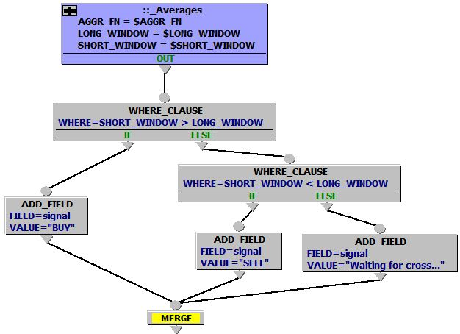
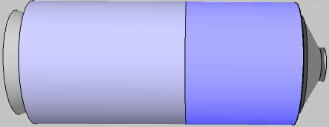

ONETICK enables you to maximize opportunities
X
Tick Server
Analytics
Clients
filter
ODBC/SQL
Real-Time Feeds
CEP Engine
enrich
Panopticon RTView
aggregate
Spotfire Tableau
Historical Data
In-memory
Database
transform
R,MATLAB
Historical
Data
Historical
Data
Reference
Data
correlate
C++ C# Java
100+ Built-In High Performance Analytical Operators + MATLAB ®
Direct support for Corporate Actions , Corrections, Cancels, Symbol Maps,…
EMS Systems,
Web Portals,
Visualization,
Messaging
Biz Intelligence,
Programming
Price & Volume Analytics, Historical VaR, …
Spread Trading signaling, Portfolio Analytics, …
Notes:
<CEP and Analytics>
A single solution involves managing tick data in both a historic and live sense. ONE Tick Complex Event Process provides that engine where user strategies execute in real-time and can leverage both live and historical market data in a seamless stitched-together manner. Market data is a valuable commodity whether it’s trades and quotes from the last microsecond or the last 2 years. Technologically advanced quant firms building today’s most advanced strategies demand ultra-high-speed access to both as a single data stream.
The binding glue between live and historic data is the analytical engine, one with a vast library of available functions. ONETick provides over 100 in-built functions for filtering, aggregating and transforming data, joining streams such as trades to the prevailing quotes and operating on complex structures such as Order Books with nanosecond precision. It includes functions for mapping symbologies between exchanges, pricing portfolios, converting currencies, manage continuous futures contracts and re-pricing options along with dozens of other functions at your fingertips.
Users can also write their own in C++, java, perl or Python. Additionally, we’ve embedded the math libraries of MATLAB and R directly in the ONETICK Server. Take advantage of their powerful mathematical capabilities such as Linear Regression or matrix calculations directly alongside ONETick’s own functions in your strategies.

Slide 10
Graphical Query Model
The Highest and Lowest 5-Minute VWAPs
Excluding Trades with Prices below Mid-Spread
Highest
5-minute
VWAP
HIGH
Compute overall
high
5 minute
VWAPs
TRD_VS_MID(“LT”)
Filtered
Trades
Quotes
VWAP(300)
Filter Trades where price is less than prevailing mid-quote price
Compute 5 minute running VWAP …
Trades
LOW
Compute overall
low
5 minute
VWAPs
Lowest
5-minute
VWAP
Notes:
Example of a real OneTick query combining two streams either from historical or real-time
Read the data flow from left to right (in the logical example).
We want to produce the highest and lowest 5-minute VWAP from a stream of filtered trades. The Trades are filtered against the prevailing mid-price of the quote. So at the time of each trade, we join it with the prevailing quote, calculate it’s mid-price (sum of bid+ask/2), if the trade price is less than that mid-price we pass the trade through to be included in the 5 minute VWAP aggregation.
This in-fact is an actual query in ONETICK and these are real functions or Event Processors

Slide 11
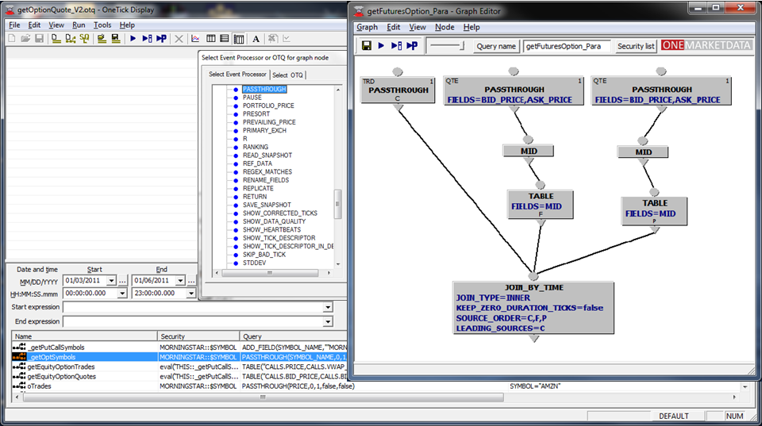
Visually Construct Quantitative Models
X
Over 100 Built-In Analytical Functions
Notes:
ONETick empowers your creativity by providing a means to graphically model the semantic logic of a strategy, what we call a query by leveraging the analytical library. That saved query is a directed graph that is natively executed by the OneTick server and maps one-to-one to the API that OneTick exposes. As a result, there is no latency-loss using the ONETick graphical modeling tool as you will find in other vendors visual tools often caused by an intermediary code-generation step or a semantic mismatch with the underlying language. ONETick’s analytical functions, all written in C++ are highly optimized and execute at nanosecond precision providing a means to accurately measure conditions to signal trade opportunities, compare trades to prevailing quotes and trades to executions.

Slide 12
Deployment
Reliable, seamless failover from multiple data sources
X
ONETICK System Components
Real-Time Data Feed[s]
Collection Server
Tick Server
Clients
Collector[s]
Raw Data Server
Collector[s]
Intraday
GUI
Collector[s]
Collector[s]
Intraday
Collector[s]
Real-Time Memory Loader[s]
Intraday
GUI
Excel
Collector[s]
MatLab
Batch Loader[s]
Collector[s]
Batch Loader[s]
Tick Server[s]
Raw Logs
CEP
API
Other..
File System Storage
File System Storage
Legend
Real-Time Write
Real-Time Read
Batch Read
Batch Write
Fault Tolerance
Primary Deployment
Notes:
An typical deployment scenario showing all the OneTick components.
A two-server configuration a) a collector server; b) a tick server
Collector Server
The purpose of this server configuration (and it’s components) is to connect to real-time market data feeds and “stage” them for eventual archival and in-memory (db) storage on the Tick Server. The Collectors and Raw Data Servers manage the data staging
b) Tick Server
This server configuration has the components to maintain both the in-memory intra-data database and persisting of data on disk for archival storage. Archives can be from the Collector Server or bulk data (batch) loading. The Tick server also includes the real-time CEP engine. All client connections are made to the Tick Server process running on the Tick Server host.

Slide 13
Real-Time Data Feed[s]
Collection Server
Tick Server
Clients
Collector[s]
Raw Data Server
Collector[s]
Intraday
GUI
Collector[s]
Collector[s]
Intraday
Collector[s]
Real-Time Memory Loader[s]
Intraday
GUI
Excel
Collector[s]
MatLab
Batch Loader[s]
Collector[s]
Batch Loader[s]
Tick Server[s]
Raw Logs
CEP
API
Other..
File System Storage
File System Storage
Primary Deployment
Secondary Deployment
Real-Time Data Feed[s]
Collection Server
Tick Server
Clients
Collector[s]
Raw Data Server
Collector[s]
Intraday
Client
Collector[s]
Collector[s]
Intraday
Collector[s]
Real-Time Memory Loader[s]
Intraday
Client
Client
Collector[s]
Batch Loader[s]
Collector[s]
Batch Loader[s]
Tick Server[s]
Raw Logs
CEP
Legend
Real-Time Write
Real-Time Read
Batch Read
Batch Write
Fault Tolerance
File System Storage
File System Storage
Notes:
<see previous slide for description of typical deployment scenario>
This shows common fault tolerant deployment – Primary and Secondary configurations (minimum 4 servers) in a redundant setup.
The goal of a fault tolerant configuration, hot-hot is to prevent data loss from the failure any one component. Each component has a backup instance.
In the event of a cataclysmic failure, gaps in data can be filled via batch loader processes.

Slide 14
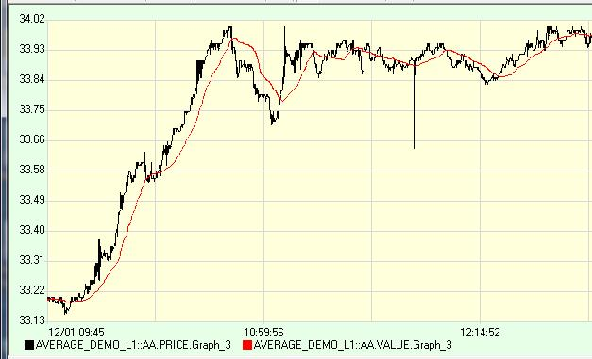


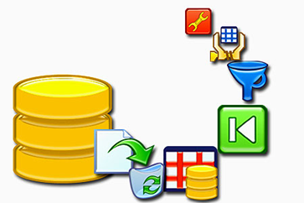
Connectivity Catalog
ONETICK Consumes the Big Data Complexity
Bulk Data Loading
ARCA
BATS Multicast PITCH
Thomson Reuters TRTH
Morningstar
Bloomberg tick
CME futures
Deutsche Bourse
Eurex Order Book
Euronext NextCash
ICAP BrokerTec
ICAP EBS
IDC DDF
LSE
NASDAQ TotalView ITCH
NYSE OpenBook
NYSE TAQ
OPRA
Spryware FASTOR
TSX
Generic ASCII Loader
Visibility
Panopticon
Tableau
SpotFire
RTView
MS Excel
Real time Collectors
Reuters RFA
Reuters OMM
NYSE Wombat 5(FAST)
ACTIV Financial
Spryware
ComStock
Lime Citrius
Bloomberg BPOD
QuantFEED
IDC PlusFeed CTF
RedLine
FIX
Interoperability
MATLAB
R
ODBC
SAS
Oracle
TibRV
Client APIs
C++
C#
Java
Perl
Python
Can monitor access usage for security entitlements, Exchange fee costing, etc.
Notes:
The ONETICK architecture includes a broad range of real-time Collectors including the major consolidators such as Reuters, Bloomberg, ACTIV Financial, NYSE/Wombat, Spryware and a host of others.
Live market data can be streamed into the CEP engine for those real-time strategies and also concurrently captured and stored.
We also provide a wide range of loaders for fast bulk loading of historical data. The architecture uses an in-memory database for today’s (daily) data and archives for longer periods.
Historical data is available from a variety of sources, one of our partners MorningStar, supply historical data for hundreds of exchanges across the equities, derivatives, foreign exchange and treasuries markets.

Slide 15


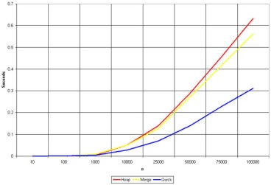
Performance Characteristics Designed to Win
ONETICK Industry leading performance
Scalable multi-threaded 64bit server architecture
Automatic thread distribution and optimization
Single-digit microsecond latency of CEP adapter for basic query
Bulk processing rate – more than 7 million ticks/sec/Core
Ability to capture all ticks globally (currently over 7 billion ticks/day)
Immediate access to the latest tick as well as years of history
Standard setup handles over 10 million data/analytics requests daily
Proprietary compression to optimize disk use and retrieval rates
Notes:
In addition to the slides bullets on performance…
What is the latency incurred by a graphical modeling tool for strategy/query design?
Many technology vendors provide a graphical modeling tool for the construction of strategies and analytical queries for trading and quantitative research. These tools do have the same objective in mind, to shorten the time from idea to deployment. But not all vendor’s tools are created equal, some do incur a penalty for that abbreviated development cycle. This has to with the graphical tool itself and its underlying technology. Many take the graphical models designed by humans and produce machine-generated source code, which by-definition can never be as efficient or as optimal as code produced by the creative mind of a human being. Furthermore, a semantic mismatch is at play between the graphical modeling paradigm and the underlying language, often causing graphical expressions to translate poorly to the run time language. The OneTick graphical modeling tool on the other hand is not one of those inefficient code-generating tools. It empowers the creativity of the user by providing a means to graphically model the semantic logic of a strategy or analytical query by leveraging our library of high-level business functions. That saved model or query is a directed graph that is natively executed by the OneTick server and maps one-to-one to the API that OneTick exposes, there is no intermediary step or semantic mismatch caused by code-generation. The library of business functions, all written in C++ are already highly optimized and finely tuned for execution in OneTick models, any function within a node on a graph represents a class, and each link between nodes is a source-sink relationship between objects of those classes. As a result of this architectural design, queries created either with our programmatic API or via graphical modeling are indistinguishable and equivalent with no loss of latency.

Slide 16
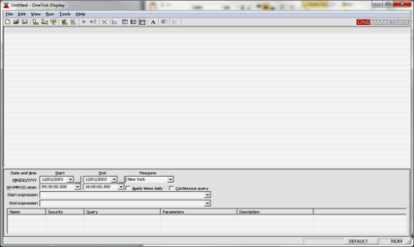

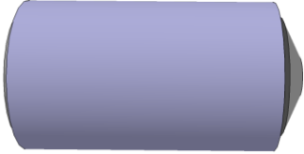
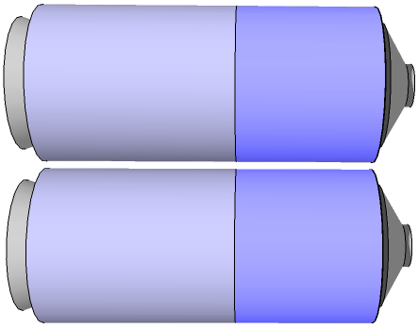
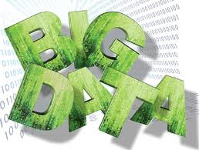
What does OneMarketData do?
ONETICK is a Market Data Storage & Analytical Solution
enabling better trade performance at a lower cost
Single-Point solution integrating historical tick data, real-time CEP and analytics
Manage, Consume, Query, Analyze years of Big Data
Asset Class neutral:
Equities, Futures, Options, FX …
Visual Query development for non-programmers
Queries
Markets
Collectors
Markets
CEP Server
Analytics
TAQ
In-memory
Database
Tick Server
TAQ
Historical
Data
Analytics
BULK Loaders
Historical
Data
Reference
Data
Notes:
It is a business-oriented product for both historic and real-time data management and analytics. Yes, ONETICK can capture and store market data from any asset class including Equities, Foreign Exchange, Futures and Options… even the massive OPRA feed. It can also store Orders and Executions for accurately measuring slippage for transaction costing. ONETICK can even store unstructured data such as news allowing you to model correlations between price actions and corporate events. Data storage can span from a few months to multiple years and we can easily apply needed cleansing and adjustments such as cancels, corrections and corporation actions without any loss of the high-performance characteristics.

Slide 17


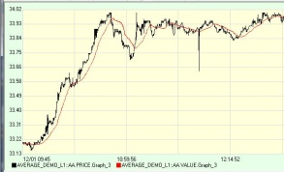
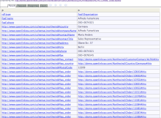
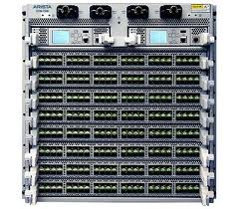
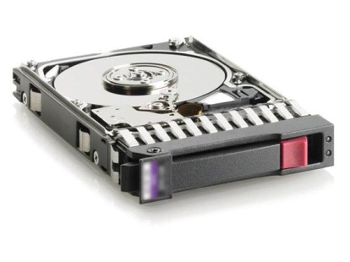
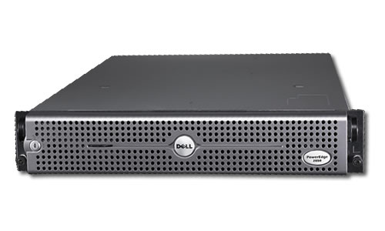
Hosting OneTick, Our Partners…
A hosted application solution for market data
North America
Europe and Asia
High performance integrated historical tick data, real-time CEP and analytics
A low latency cloud-based infrastructure, a complete managed service
Analytics
Connections
Data
Application Services… ONETICK
Archived
Data
Data Center Infrastructure
Servers
Networks
Storage
Notes:
It is a business-oriented product for both historic and real-time data management and analytics. Yes, ONETICK can capture and store market data from any asset class including Equities, Foreign Exchange, Futures and Options… even the massive OPRA feed. It can also store Orders and Executions for accurately measuring slippage for transaction costing. ONETICK can even store unstructured data such as news allowing you to model correlations between price actions and corporate events. Data storage can span from a few months to multiple years and we can easily apply needed cleansing and adjustments such as cancels, corrections and corporation actions without any loss of the high-performance characteristics.

Slide 18

What is ONEQUANTDATA, Managing Bread/Depth of History
Comprehensive Global Pricing for last 40 years
100,000 symbols global markets
Broad Universe of daily closing prices
Stocks, ETFs, Mutual Funds, Warrants, Pink Sheets
Historical Reference Data for Security Continuity
Exchange Symbol Maps across Ticker, CUSIP, …
Corporation Actions (symbol, price, volume changes)
Descriptive Company Information
Earnings, Market Cap, Shares outstanding, Dividends, …
Delivered as subscription service with daily updates
Users can Focus on Analysing Data and not Process Data
= Captured, Stored and Managed in the ONETICK database

Slide 19
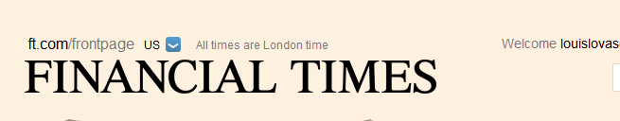
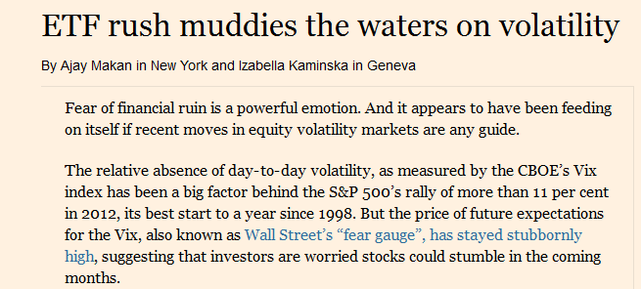

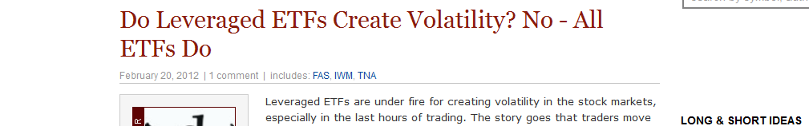

ONEQUANTDATA, Confidence to Compete
Current News Affecting Analysis
Data Management & Analytics with ONETICK and ONEQUANTDATA
Gain deeper historical and statistical perspective for confidence in trading models
Historical Volatility across asset classes and time periods
Impact of “Big Stories” – ETF Impact, Bubble Periods, Market Crashes, Bull/Bear
Notes:
OneQuantData is a comprehensive repository of historical reference and pricing data designed specifically for the global equities market.
OneQuantData is a fully integrated solution harnessing the power of OneTick
Access deep history across a broad universe of multiple asset classes including daily closing prices for Stocks, ETFs, Mutual Funds, Warrants and Pink Sheets.
Also includes descriptive information on company name, market cap, shares outstanding, announced earnings, dividends, and more.
Overall provides Data Modeling on three levels - Company level, security level and exchange level (pricing info).
Symbol Mappings and Unique IDs assigned by OneMarketData’s team of experts ensure the highest quality of data and continuity across a road spectrum of over 100,000 global symbols.
Provides reference information for Corporate Actions represented as additive/multiplicative adjustments, useful for price and volume adjustments for return calculations, vital aspects of portfolio management.
Complete history of symbol name changes and mappings between CUSIP, ISIN, SEDOL, Ticker across the global universe.

Slide 20

Industry Advantages Where Your Success Counts
ONE
TICK
Data Management & Analytics, the ONE in ONETICK
Write once, strategy logic amenable to historic and real-time
High Performance/High precision time-series analytics
Stitch history and real-time as one single data stream
Profitable Strategy development
Be first to market with fast development
Intuitive Visual modeling with no latency penalty
Familiar Run-time Standards: SQL & ODBC and Java, C++, C# APIs
Built from the ‘Ground-Up’ for Financial Data
Content-Aware: Trades, Quotes, Orderbooks, Executions across all asset classes
Capture, Query, Analyze multi-terabytes of high-frequency data in real-time or batch
Outsmart the Competition
= Lowest TCO (Total Cost of Ownership) to Outsmart the Competition
Notes:
The ONETICK advantages are technology with a purpose.
OneTICK has the intelligence to blend together the past with the present, not just for trades but also for complex structures such as Order Books. User strategies can interact with a single data stream that is a seamless view of historical and live data.
OneTick’s graphical strategy development tool makes their construction an approachable task for traders and quants. You can focus on modeling semantic logic visually leveraging a large library of analytics. The OneTICK server where your strategies run is an Enterprise-class product that leverages multi-core hardware and manages thread pooling for massive scalability. Invoking strategies is always from the familiar. Your controlling clients, such as trading applications, EMS systems whether institutional or retail can be from common programming languages such as C++ and java and standard methodologies including SQL.
It can do this because it was designed from ground up for market data. The ONETick internal architecture understands and recognizes the nuances of market data and most importantly how users want to access and analyze the markets. For example, ONETick can instantly re-construct an Order Book from any starting point within the day; there is no need to waste precious time and processing power replaying data from the beginning of the trading day. ONETick can aggregate Books coming from different exchanges, even seamlessly blend a historic Order Book with the current active book. It also understands how symbologies are formatted differently across asset classes, it can easily handle rolling futures contracts and equity symbol name changes as well.
These advantages are the one in ONETICK adding up to the lowest total cost of ownership in the industry. To achieve what OneTick provides in-the-box would take multiple vendor products and a whole lot of custom code. ONETICK is your single source solution to tick data management

Slide 21
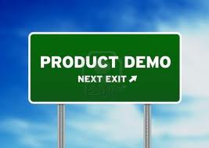

Industry Advantages Where Your Success Counts
ONETICK
Product Demonstration

Slide 22
Contacts
Tim King (Director of Sales, EMEA)
+44 (0)7956 370 340
Tim.King@onetick.com
Andrew Diamond (Client Services, EMEA)
+44 (0)7803 605 071
Andrew.Diamond@onetick.com
Ursit Patel (Client Services, EMEA)
+44 (0)7968 890 892
Ursit.Patel@onetick.com

